Slide 1
RSC PARERS notes 11/22/24
RNA Editing Deep Sequencing Analysis
Tyler Rodshagen, Max Tracy, Jason Carnes, Suzanne McDermott, & Brittney Davidge

Slide 2
Part 1: Background on RNA editing
This section includes information about the RNA editing process in T. brucei and our wet-lab experiments including an overview of our PCR and sequencing protocols

Slide 3
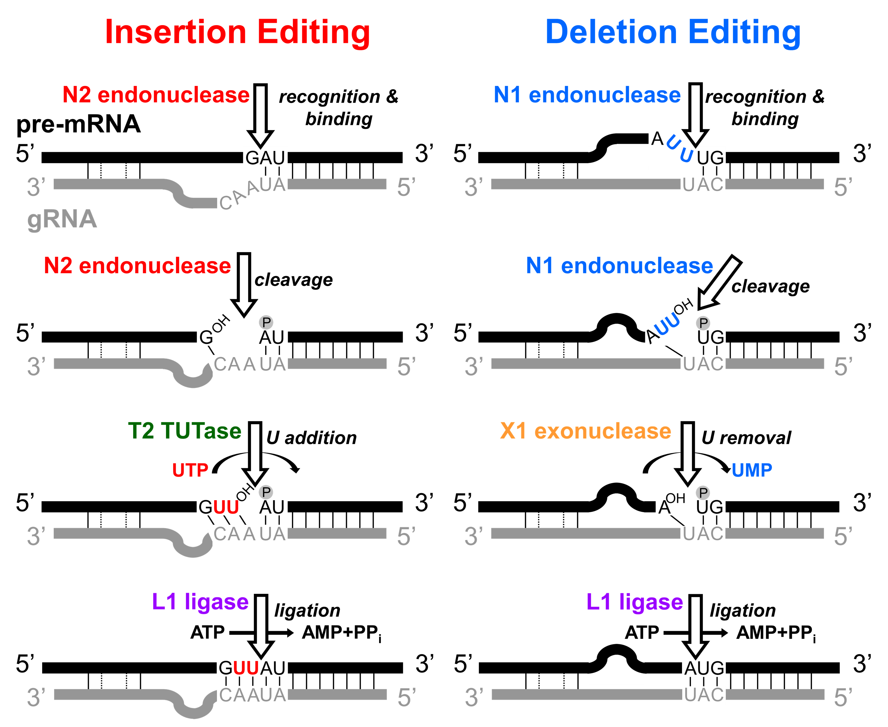
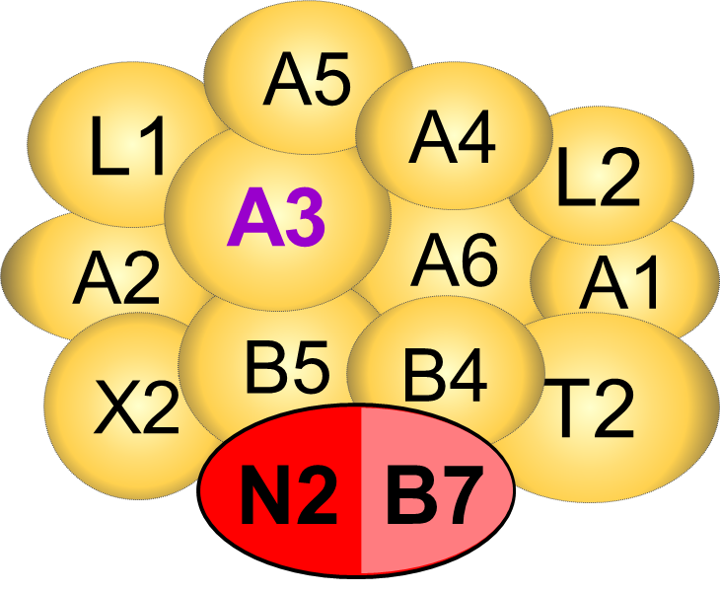
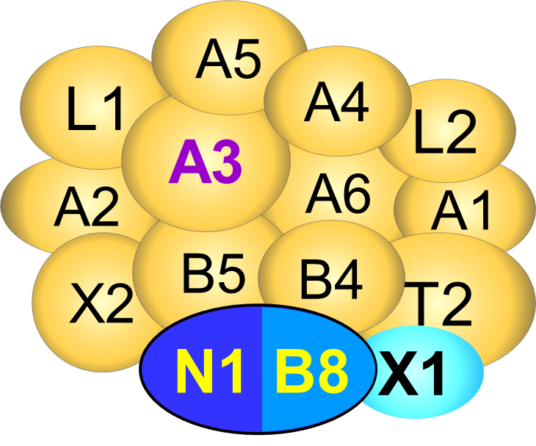
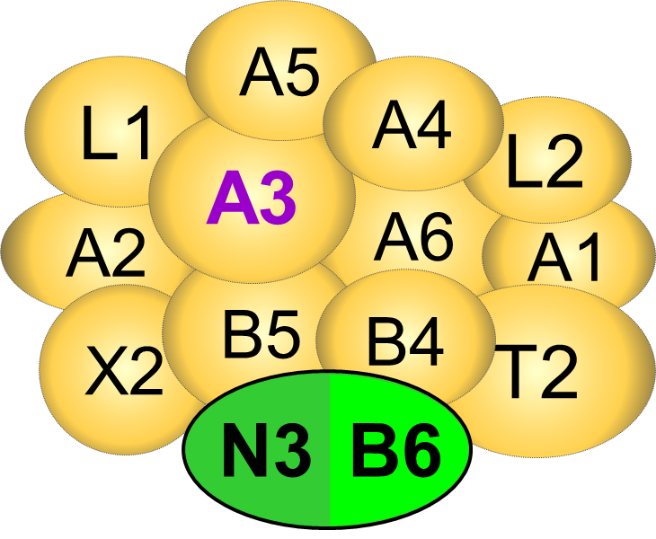
Catalytic steps of editing by 3 distinct RECCs
RECC2
RECC1
RECC3
Notes:
RNA editing requires three distinct RECCs that have mutually exclusive dimeric endonucleases, and 12 proteins in common.
Together these complexes recognize ESs, cleave, add or remove Us according to template gRNA, and religate mRNA fragments.

Slide 4
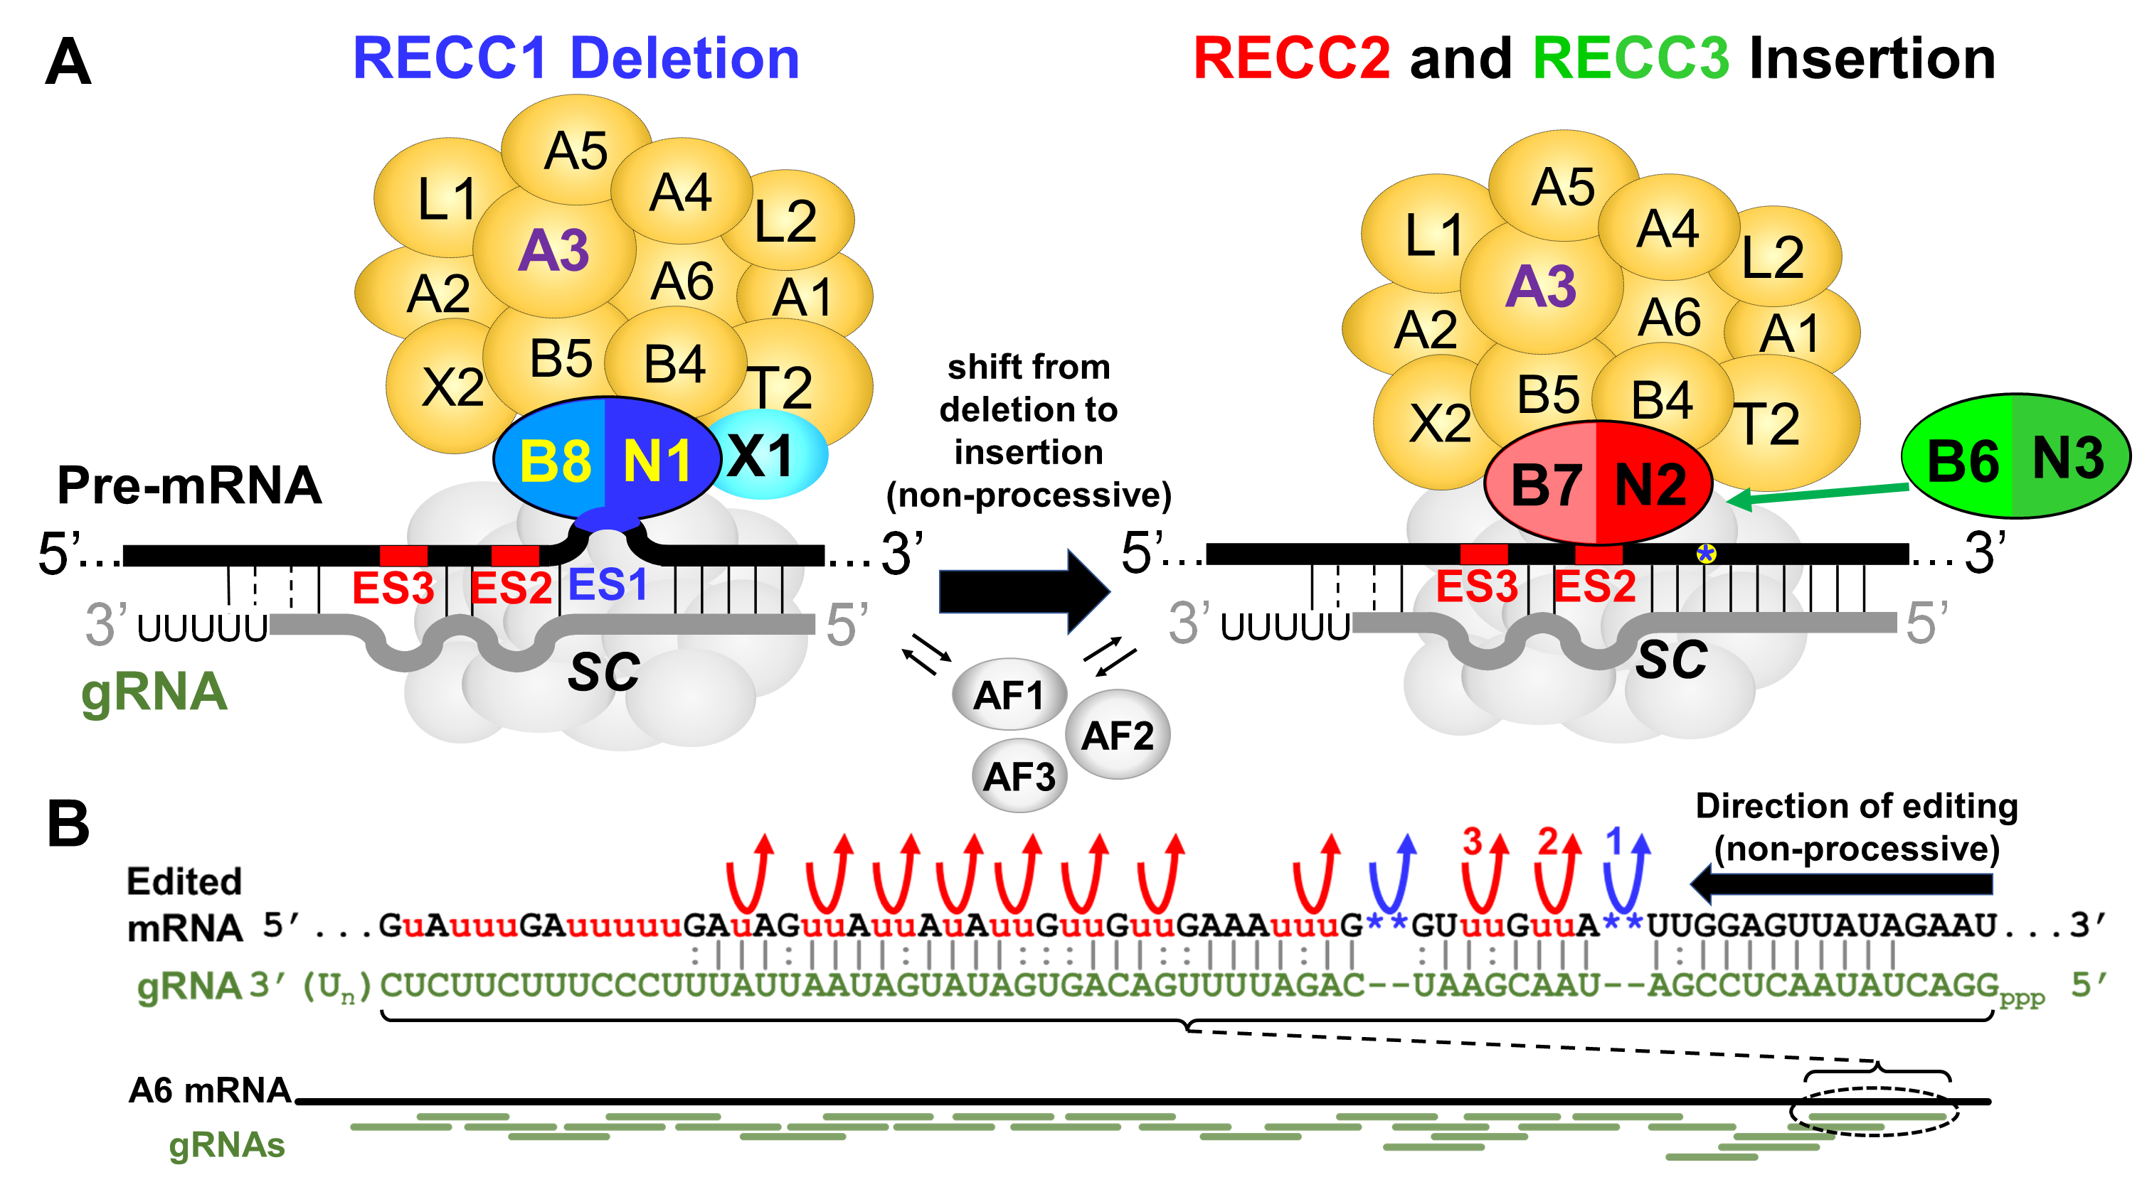
RECCs are non-processive site to site
REH2C
Carnes, Mol Biochem Parasitol. 2023
Notes:
We recently published work that demonstrates editing is non-processive, as transition from a deletion editing site to an insertion editing site involves RECC1 editing the first site, then an entirely different RECC2 (or RECC3) editing the insertion site. Many other proteins are involved, as the substrates are presented by RESCs, and REH2C helicase complex and multiple accessory factors are required.
Important to keep in mind that each gRNA serves as template for multiple ESs, and that multiple gRNAs are required for editing complete mRNAs.

Slide 5
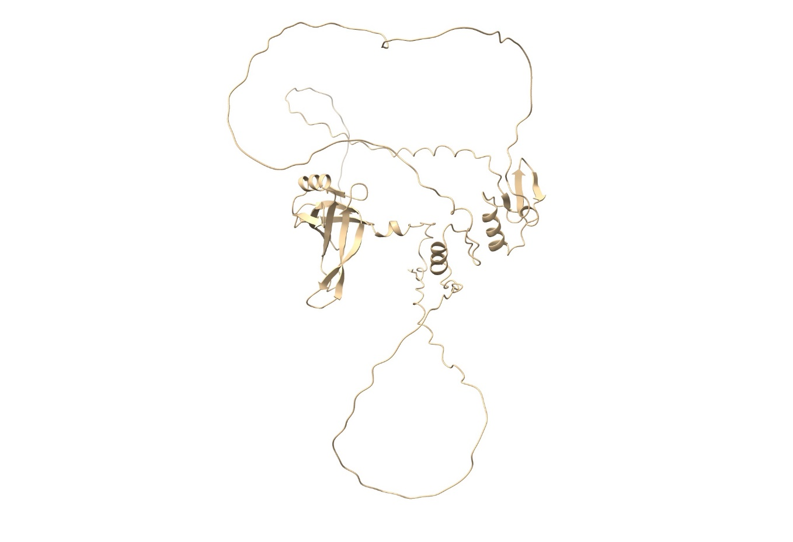
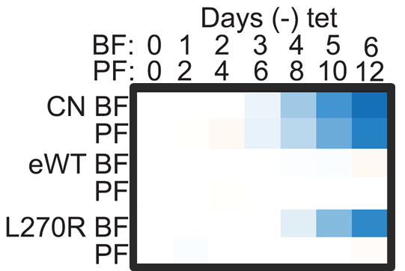
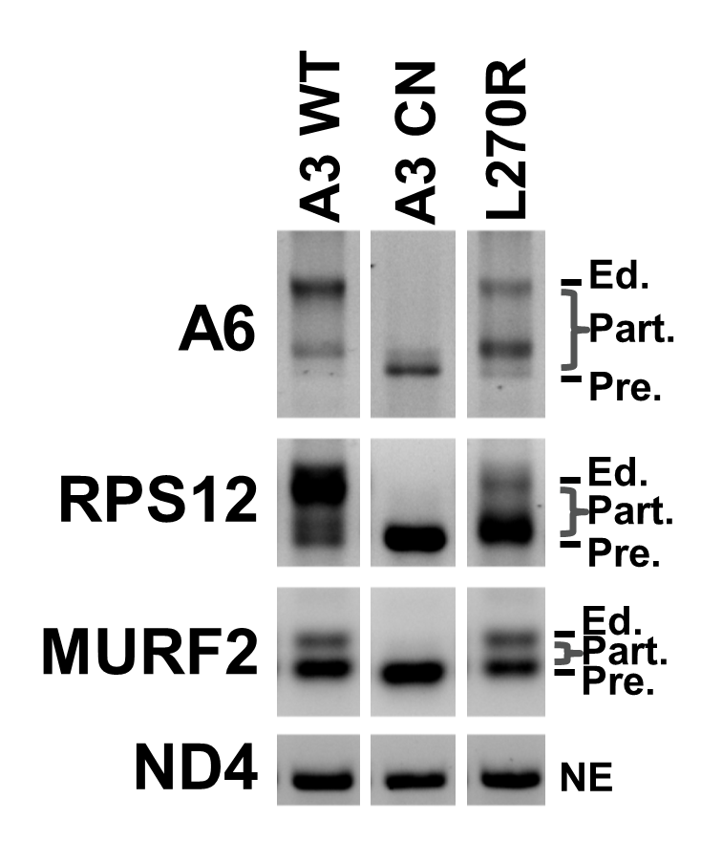
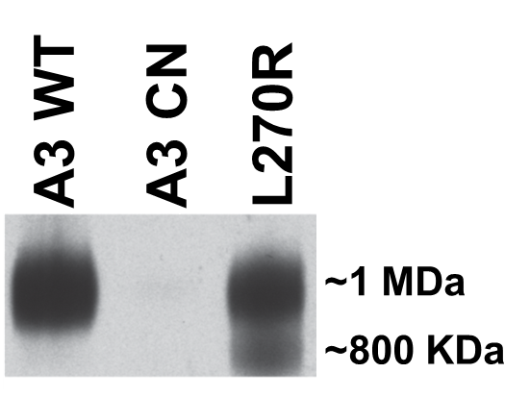
A3 domain structure and background
Analysis of A3 function (all RECCs)
A3 AlphaFold
Growth
Editing profile
OB-fold
log2 ratio -/+ tet
RECC Integrity
ZFs
L270
Davidge, RNA. 2023
Notes:
Brittany Davidge recently published the results of a similar random mutagenesis screen in A3, which has and OB-fold domain and 2 ZFs. A particular mutant of interest, which will be the focus of the rest of my talk, L270R is located in a predicted IDR adjacent to the OB fold, and its exclusive expression strongly affects growth in BF but not PF. While complete loss of A3 in the CN essentially eliminates RECCs as seen on this native western, L270R retains a lot of 1MDa RECC and also has a subcomplex around 800 kDa. Importantly, editing is altered but not eliminated when L270R is exclusively expressed by RT-PCR profiling.

Slide 6
Gene-specific RT-PCRs for deep sequencing editing events
Total RNA isolated (Trizol)
DNase I treatment (DNAfree Turbo)
Reverse transcription (Multiscribe) with gene-specific REV primer containing UMI and Illumina adaptor seq
2nd strand synthesis with gene-specific FOR primer containing UMI (NEB Next Pol)
Exonuclease I treatment to remove unincorporated oligos
Aliquot of Exo I-treated ds-cDNA PCR amplified using universal Illumina adaptor primers
Gel purify products in the region of pre-edited to fully edited amplicons
Quantify by Qubit fluorometer
Indexing PCR for Illumina sequencing
Gel purify products in the region of pre-edited to fully edited amplicons
Load equimolar amounts for mixed libraries on Illumina flow cell with PhiX

Slide 7
Example gene-specific RT-PCRs of MURF2 and ND7-5’ for deep sequencing editing events
BF A3 CN + WT or L270R mutant
Note the different sizes of the bands in these PCR lanes. These different sizes are the result of a heterogenous population of mRNAs that have different amounts of editing. As a result, each sequenced sample has reads that are expected to be different lengths due to variations in U content.
Notes:
Murf2 Expected amplicon size: 77 – 99 bp
Nd7 5’ Expected amplicon size: 127 – 185 bp

Slide 8
Part 2: Examples of current data outputs
The three main types of outputs from PARERS are:
Bar graphs showing an overview of the types of editing that happened at each editing site
“Bubble plots” which provide a detailed accounting of the number of Us at each editing site
Sequence alignments and examples of the most frequently-observed reads

Slide 9
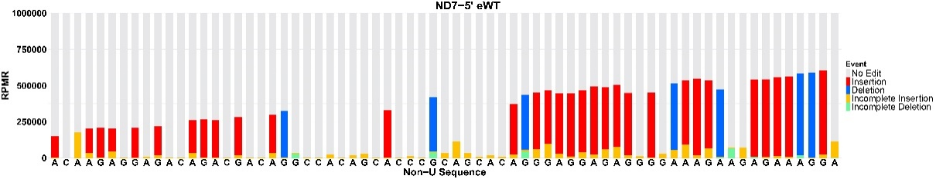
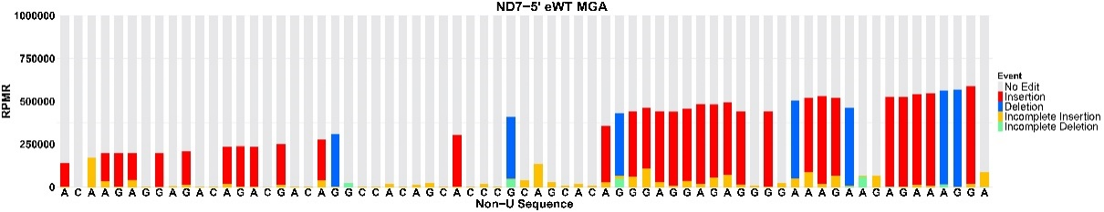
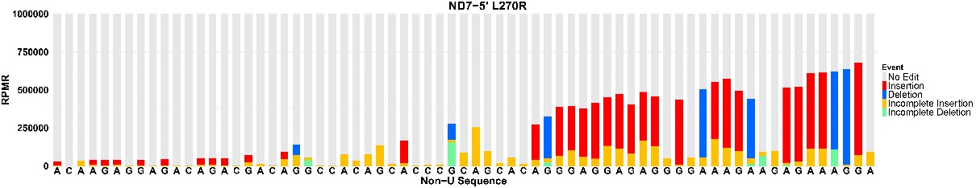
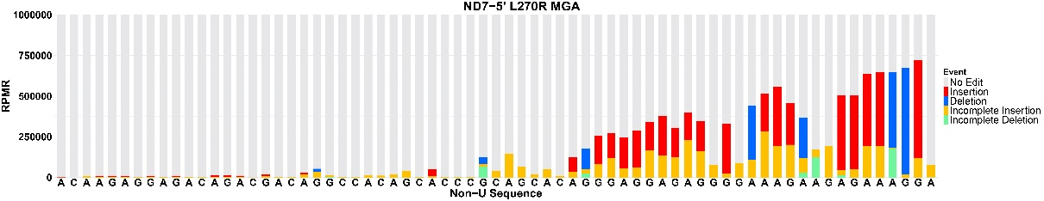
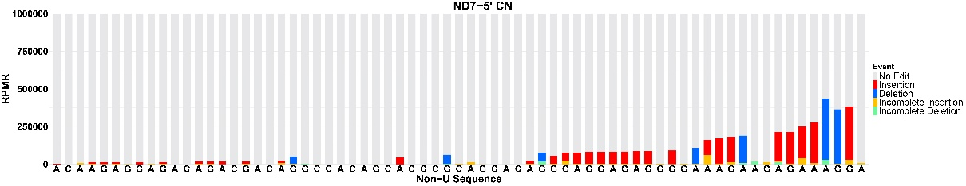
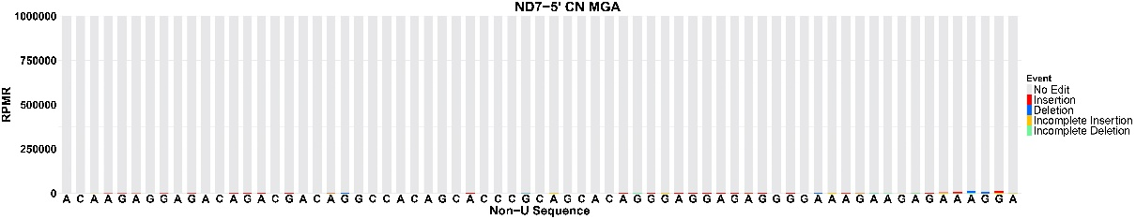
MGA exacerbates consequences of A3 L270R substitution (example ND7-5’ domain RNAseq)
100
WT
WT MGA
75
% Reads
50
25
0
100
L270R
L270R MGA
75
% Reads
50
25
0
100
CN
CN MGA
75
% Reads
50
25
0
5’
Position in ND7-5’ mRNA
3’
5’
Position in ND7-5’ mRNA
3’
Legend:
Insertion
Deletion
Incomplete Insertion
Incomplete Deletion
No edit
Carnes, unpublished
log2 ratio -/+ tet
Notes:
Here I’m showing plots of aggregated read percentages at each editing site (ES) in the ND7 5’ domain with the 3’ end on the right. Red is complete U insertion, Blue complete deletion, yellow is incomplete insertion, green is incomplete deletion, and gray is no edit. First, WT and WT MGA are virtually identical, as expected. Exclusive expression of L270R shows editing loss at the 5’ end, and slightly altered editing at the 3’ end. Thus phenotype is exacerbated by MGA, where increased incomplete insertion is particularly noticeable. The residual editing in CN is essentially eliminated in CN MGA. Editing sites (ESs) are defined as positions between two non-U nucleotides and each ES is indicated in this graph as a single bar. The non-U sequence is shown below the bars to indicate position. Editing happens in the 3’ to 5’ direction. 3’ and 5’ ends of the edited region are indicated.

Slide 10
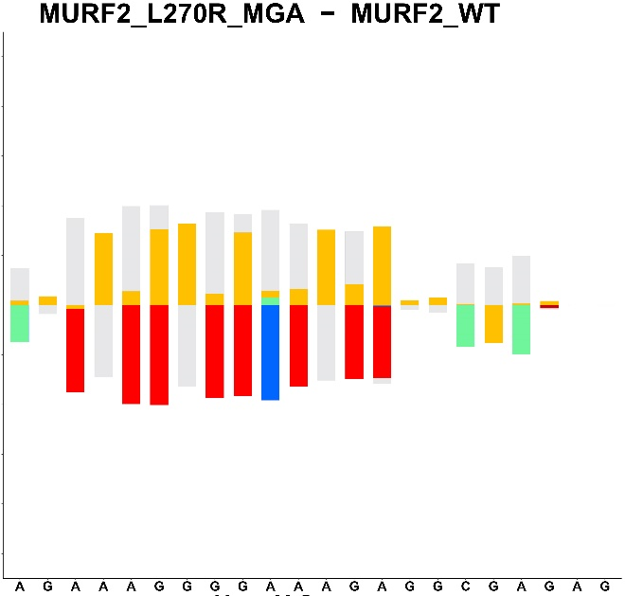
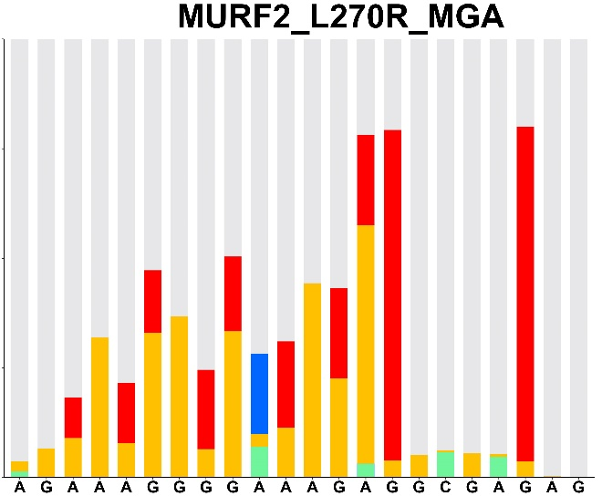
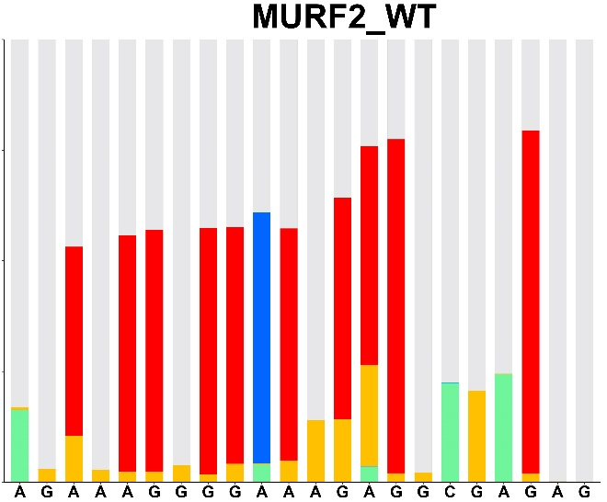
A3 L270R Difference plots of MURF2 RNAseq
100
L270R MGA - WT
100
WT
L270R MGA
80
60
Up in L270R
75
40
20
% Reads
50
0
-20
25
-40
Down in L270R
-60
-80
0
-100
Position in MURF2 mRNA
Position in MURF2 mRNA
5’
3’
5’
3’
Position in MURF2 mRNA
5’
3’
L270R has decreased complete editing and increased incomplete insertion
Legend:
Insertion
Deletion
Incomplete Insertion
Incomplete Deletion
No edit
Carnes, unpublished
Notes:
If we look at editing of MURF2 mRNA, which has a smaller edited region, we again notice an increase in incomplete insertion compared to WT, which is made more obvious by this difference plot where we subtract WT reads from L270R MGA, showing sites with no editing or incomplete insertion going up in L270R, and complete editing going down.

Slide 11
Example bubble plots, which count the proportion of reads with each number of Us at every editing site.
Red= insertions that match fully edited and Blue= deletion matching FE. No editing is shown in grey and all other edits are black
Notes:
This type of data display provides more detailed information about the editing at each ES.

Slide 12
A3 L270R substitution results in insertion at deletion sites in A6 and ND8
Editing of A6 altered by L270R
Editing of ND8 altered by L270R
Carnes, unpublished
Notes:
Now, looking at just the 3’ most editing sites in A6 and ND8, if we drill down to the most frequent read sequences, we see large differences between L270R and WT. Not surprisingly, for both the L270R results in reduced fully edited and increased pre-edited reads. Interestingly we also observed U insertion at deletion sites at much higher frequences in L270R. In particular these ND8 sequences were observed tens of thousands of times in L270R, but less than 10 reads in WT.

Slide 13
Sequence alignment comparing common 3’ end sequences from the A6 mRNA and their proportion in different cell lines
*This type of data display is found in the ‘inter cell line analysis’ folder that PARERS produces for each set of samples. Here, frequent 3’ end sequences (specified by ‘depth’ in the Input_Temp.txt file) are shown on the left and the percent of each in different KREPA6 mutant cell lines are shown on the right.

Slide 14
Part 3: PARERS outline and details
Pipeline Analyzing RNA Editing RNA Sequencing (PARERS)
This section includes a PARERS overview and examples showing the logic behind how some of the data outputs are generated

Slide 15
Overview of PARERS pipeline
Raw reads come in fastq.gz format. Forward and Reverse reads are input separately into PARERS. You can run multiple samples at the same time as long as the gene being analyzed is the same
Reads are merged using PARERS via BBMerge (uses Java)
Primer selecting to retain sequences with correct base calls in both 5’ and 3’ primers
UMI deduplication to remove sequences with duplicate UMIs. Note: At this step when two sequences have the same UMI but different mRNA sequences, one is randomly selected to ‘keep’ in the pipeline, since there is no way to know which one of the two would be ‘correct’. However, if the same data set is re-run multiple times, you will notice variation in a very small number of reads retained after this step resulting from this random selection.
Sequences are T stripped and only those with expected non-T sequence are retained
Three types of data outputs are generated using R and Python in addition to a “QC document” detailing the reads retained at each filtering step. At this step, several ‘intermediate’ files are made that are automatically deleted before the process ends
1. Sequence alignments for each cell line
3. “Inter-cell line analyses” including difference bar graphs and alignments
2. Bar graphs and bubble plots for each cell line
Condense identical reads (with Ts in sequences)
Order reads by observed frequency
With T-stripping process, Generate T counts for all sequences
These outputs are stored in a new folder within the destination folder. They include comparisons between the mutant cell lines and the designated control.
Create read sequence alignments
Bubble plots and bar graphs created in R
Assign designations to edited Us and annotate with color. The alignments are output as Excel workbooks
Outputs include alignments and bar graphs comparing either all the cell lines or each cell line to the control. Other information, including a calculation of unique reads in each sample are also included in this folder.
PARERS also outputs .csv files with this data

Slide 16
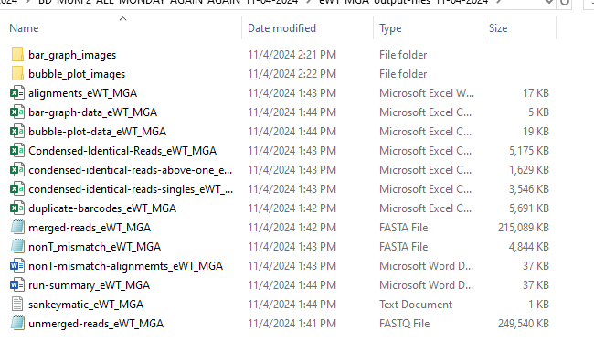
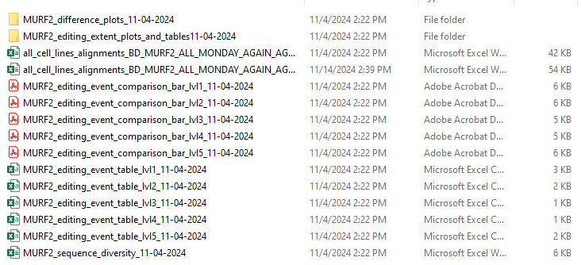
Running PARERS using PyCharm
Inputs
Outputs
“Input_Temp.txt” file which contains information like gene to analyze, primers, specifications for graphs etc
“AmpliconsRaw.fasta” file contains the pre-edited and edited gene sequences
R1 and R2 fastq.gz files for analysis
Test data on GitHub are plain fastq files, I have adjusted the code to run on these and not fastq.gz files
All of these file paths should be provided to PARERS, then everything can run all at once. Multiple samples can be run at the same time as long as they are for the same amplicon.
PARERS make a folder in the specified working directory for each run. The name of this folder is specified in the “Input_Temp” text file
In the folder there will be subfolders for each cell line analyzed and another subfolder called ‘inter cell line analysis’.
PARERS also makes a temporary folder for storing intermediate files and this is automatically deleted before the process finishes.
Examples of some MURF2 output folders are shown:
Example contents of eWT output folder:
Example contents of MURF2 ‘inter cell line analysis’ output folder:

Slide 17
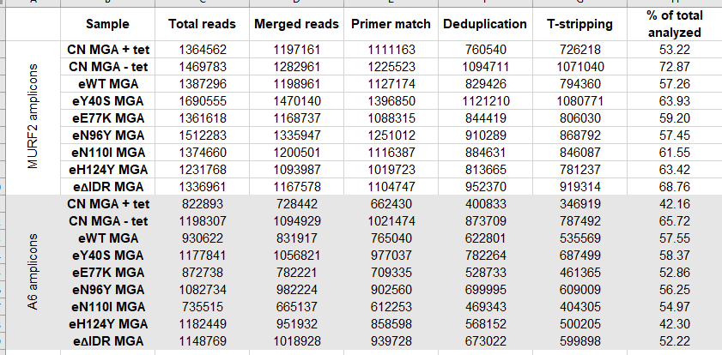
Deep Seq analysis: example filtering steps to identify bona fide RNA editing sequences
*This example shows the number of reads remaining following each of the PARERS filtering steps.
Davidge et al, unpublished
Notes:
This slide shows examples from two amplicons with the number of reads remaining after each PARERS step.

Slide 18
Sequences for Primer Selection filter
MURF2 L270R merged read examples
>M01375:305:000000000-DHV7H:1:1101:10000:10885_1:N:0:2
ATAGAAAGGTATATAATCTATAATGAAAGGGGATTTTAAGATTGGCTTTGATTGAGTCGTGTTTTTGATTTGTTATG
5’ Primer
3’ Primer
5’ Primer filter
3’ Primer filter
>M01375:305:000000000-DHV7H:1:1101:10000:22416_1:N:0:2
ATAGAAAGGTATATAATCTATAATGATTTTAATGTTTGGTTGTTTTTATATTTATTGTTTATTTTTTTTTGTGCTTTGATTGTAGTCGTGTTTTTGATTTGTTATG
5’ Primer
3’ Primer
5’ Primer filter
3’ Primer filter
Notes:
This example shows the MURF2 primers used for the filtering step. Note that the length of sequence between the two primers differs between the different reads based on how much editing happened. Each transcript (MURF2, A6, ND7 etc) will have different primers, which is something the user will need to update in the “Input_Temp.txt” file prior to running PARERS.

Slide 19
Identical Read Frequencies, and Alignments
MURF2 L270R Data
Pre-Edited: ATAGAAAGGTATATAATCTATAATGAAAGGGGATTTTAAGATTGGCTTTGATTGAGTCGTGTTTTTGATTTGTTATG
Full-Edited: ATAGAAAGGTATATAATCTATAATGATTTTAATGTTTGGTTGTTTTAATTTAGTTTTATTTTTGTGCTTTGATTGTAGTCGTGTTTTTGATTTGTTATG
Count:
119876
58412
24601
11413
9956
9284
Read:
ATAGAAAGGTATATAATCTATAATGAAAGGGGATTTTAAGATTGGCTTTGATTGAGTCGTGTTTTTGATTTGTTATG
ATAGAAAGGTATATAATCTATAATGATTTTAATGTTTGGTTGTTTTAATTTAGTTTTATTTTTGTGCTTTGATTGTAGTCGTGTTTTTGATTTGTTATG
ATAGAAAGGTATATAATCTATAATGAAAGGGGATTTTAAGATTTTTTTTTGTGCTTTGATTGTAGTCGTGTTTTTGATTTGTTATG
ATAGAAAGGTATATAATCTATAATGAATTTTAGTGTTTGGTTATTTTAATTTGATTTTTTTTTGTGCTTTGATTGTAGTCGTGTTTTTGATTTGTTATG
ATAGAAAGGTATATAATCTATAATGAAAGGGGATTTTAATTGTTTATTTTTTTTTGTGCTTTGATTGTAGTCGTGTTTTTGATTTGTTATG
ATAGAAAGGTATATAATCTATAATGAAAGGGGATTTTAAGATTGGCTTTGATTGTAGTCGTGTTTTTGATTTGTTATG
In order to generate alignments, we need a ‘Maximally’ T-edited reference sequence:
ATAGAAAGGTATATAATCTATAATGATTTTATTTTATGTTTGTTTGTTGTTTTATTTTATTTATTTGTTTTATTTTTTTTTTGTGCTTTGTTATTGTAGTCGTGTTTTTGATTTGTTATG
Count:
119876
58412
11413
24601
9956
9284
8759
8311
7799
5337
Alignments
AUAUAAUCUAUAAUGA----A----A-G---G---G--G----AUUUUA---A---G----A--------UUG-GCUUUG--AUUG-AGUCGUGUUU
AUAUAAUCUAUAAUGAuuuuA----AuGuuuG---GuuGuuuuA****AuuuA---GuuuuA-----uuuUUGuGCUUUG--AUUGuAGUCGUGUUU
AUAUAAUCUAUAAUGA----AuuuuA-G--uGuuuG--G--uuAUUUUA---AuuuG----A-uuuuuuuUUGuGCUUUG--AUUGuAGUCGUGUUU
AUAUAAUCUAUAAUGA----A----A-G---G---G--G----AUUUUA---A---G----A-uuuuuuuUUGuGCUUUG--AUUGuAGUCGUGUUU
AUAUAAUCUAUAAUGA----A----A-G---G---G--G----AUUUUA---A-uuG-uuuA-uuuuuuuUUGuGCUUUG--AUUGuAGUCGUGUUU
AUAUAAUCUAUAAUGA----A----A-G---G---G--G----AUUUUA---A---G----A--------UUG-GCUUUG--AUUGuAGUCGUGUUU
AUAUAAUCUAUAAUGA----AuuuuA-G--uGuuuG--G--uuAUUUUA---AuuuG----AuuuuuuuuUUGuGCUUUG--AUUGuAGUCGUGUUU
AUAUAAUCUAUAAUGA----A----A-G---G---G--G----AUUUUA---A---G----AuuuuuuuuUUGuGCUUUG--AUUGuAGUCGUGUUU
AUAUAAUCUAUAAUGA-uuuA----AuGuuuG---GuuGuuuuA****AuuuA---GuuuuA-----uuuUUGuGCUUUG--AUUGuAGUCGUGUUU
AUAUAAUCUAUAA*GAuuuuA----AuGuuuG---GuuGuuuuA****AuuuA---GuuuuA-----uuuUUGuGCUUUG--AUUGuAGUCGUGUUU
Pre-Edited
Full-Edited

Slide 20
Classifying Ts at each Editing Site
To investigate editing in depth, we need analysis on presence of T’s at any given editing site
Global position for a given sequence will not achieve this
No editing at Editing site
AATGAAAGGGG|ATTTTAAGATTGGCTTTGATTGA
AATGAAAGGGG|ATTTTAAGATTGGCTTTGATTGA
AATGAAAGGGG|ATTTTAAGATTGGCTTTGATTGA
AATTTGATTTTAATGTTTGGTTGTTTTAATTTAGTTTTATTTTTGTGCTTTGATTGTA
AATGATTTTAATGTTTGGTTGTTTTAATTTAGTTTTATTTTTGTGCTTTGATTGTA
AATGAAAGGGG|ATTTTAAGATTGGCTTTGATTGA
AATGTATTTTTTTAAGTGTTTTGTTGTTTTTTTATTATTTTAGTTTTTTTTTATTTTTTTTTGTGCTTTGATTGTA
AATGATATTTAGTGTTTGGTTATTTTAATTTGTTTTATTTTGTGCTTTGATTGTA
AATGAAAGGGG|ATTTTAAGATTGGCTTTGATTGA
AATGAAAGGGG|ATTTTAAGTTATTTTTTTTTGTGCTTTGATTGTA
AATGAATTTTAGTGTTTGGTTATTTTAATTGATTTTTTTTTGTGCTTTGATTGTA
MURF2 L270R Sample Reads
Same editing site, with editing
T stripped versions of these sequences offer a path forward, since the positional reference would remain the same across all sequences
Notes:
Murf2 L270R data, example set of reads
Primer ends appended off here for clarity

Slide 21
Non-T Sequence Selection and Subsequent T-Counts
MURF2 Pre-edited
ATAGAAAGGTATATAATCTATAATGAAAGGGGATTTTAAGATTGGCTTTGATTGAGTCGTGTTTTTGATTTGTTATG
Sequence w/ Ts
AAGAAAGGAAAACAAAGAAAGGGGAAAGAGGCGAGAGCGGGAGAG
T-strip Sequence
11th A
3rd G
T-counts
A: [1, 0, 0, 0, 0, 1, 1, 0, 1, 1, 0, 1, 0, 0, 0, 4, 0, 0, 2, 2, 0, 3, 1]
C: [1, 3, 0]
G: [0, 0, 1, 0, 0, 0, 0, 0, 0, 0, 0, 0, 0, 1, 1, 5, 0, 2]
MURF2 Full-edited
ATAGAAAGGTATATAATCTATAATGATTTTAATGTTTGGTTGTTTTA****ATTTAGTTTTATTTTTGTGCTTTGATTGTAGTCGTGTTTTTGATTTGTTATG
AAGAAAGGAAAACAAAGAAAGGGGAAAGAGGCGAGAGCGGGAGAG
11th A
3rd G
T-counts
A: [1, 0, 0, 0, 0, 1, 1, 0, 1, 1, 0, 1, 4, 0, 1, 0, 3, 0, 5, 2, 0, 3, 1]
C: [1, 3, 0]
G: [0, 0, 1, 0, 3, 0, 2, 4, 4, 1, 0, 0, 1, 1, 1, 5, 0, 2]
Notes:
‘3rd G’ is the 4th G in the T counts list because of pythons indexes the lists starting at 0. The first element is always 0 but I wanted to preserve this numbering as it makes the next slide make more sense

Slide 22
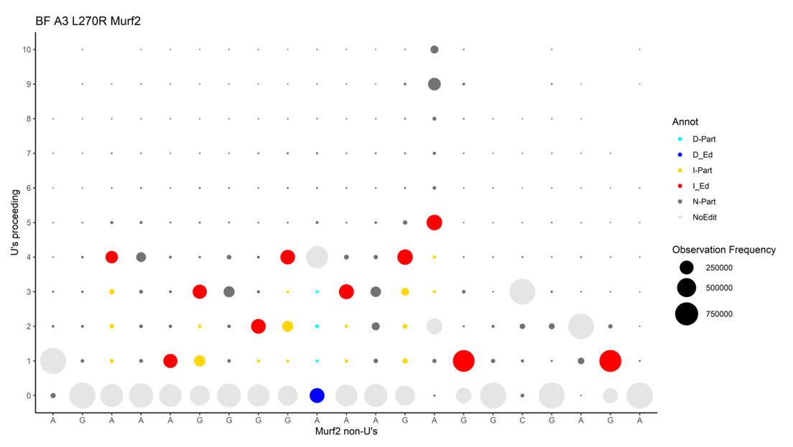
T-Counts, Compiled and Ordered
This column contains the indices from Python (As, Cs, and Gs, were indexed separately)
This column contains the new indices to be used by R. (starting with ‘1’ and in nucleotide order)
MURF2 BF A3 L270R data is displayed here →
Entire dataset for a sample is integrated into one .csv file
These data can be incorporated into graphs that display frequency of types of editing at any given editing site
Note: The data display for the bubble plot is an older version, but the way PARERS counts the Ts is the same
Notes:
These next few slides show examples of how the bubble plots are generated from the ‘bubble-plot-data.csv’ output.

Slide 23
T-Counts, Compiled and Ordered
MURF2 BF A3 L270R data is displayed here →
Entire dataset for a sample is integrated into one csv file
These data can be incorporated into graphs that display frequency of types of editing at any given editing site

Slide 24

T-Counts, Compiled and Ordered
MURF2 BF A3 L270R data is displayed here →
Entire dataset for a sample is integrated into one csv file
These data can be incorporated into graphs that display frequency of types of editing at any given editing site

Slide 25
Bar Graph Editing Rules
Comparison of T counts at a given editing site, between the sample, pre-edited, and fully-edited sequence
Full-Edited:
Pre-Edited:
Sample read:
0 1 1 0 2 2 0 2 0
0 0 2 1 1 0 0 2 2
0 1 1 1 1 1 1 1 1
No Edit
Insertion
No Edit
No Edit
Incomplete deletion
Deletion
Incomplete insertion
Incomplete insertion
Incomplete deletion
ATAGAAAGGTATATAATCTATAATGATTTTAATGTTTGGTTGTTTTA****ATTTAGTTTTATTTTTGTGCTTTGATTGTAGTCGTGTTTTTGATTTGTTATG
Full-Edited:
Pre-Edited:
Sample read:
GTTTTA
GA
GTTTTA
GTA
GTTTTTTA
GTTTTA
(a single ES for example)
“Insertion” (matches fully-edited)
Incomplete insertion
Incomplete insertion
Notes:
I like to think of PARERS as a fancy “U-counter”. It counts the numbers of Us at each editing site for all of the reads. The based on the numbers of Us, each ES for every read will be categorized and processed for data outputs. This slide shows examples of the current categories we are using. They are not perfect, but we agree they are the easiest for people to interpret. There are other categories built-in to PARERS that also provide different outputs for cases when the user prefers something different (see next slide).

Slide 26
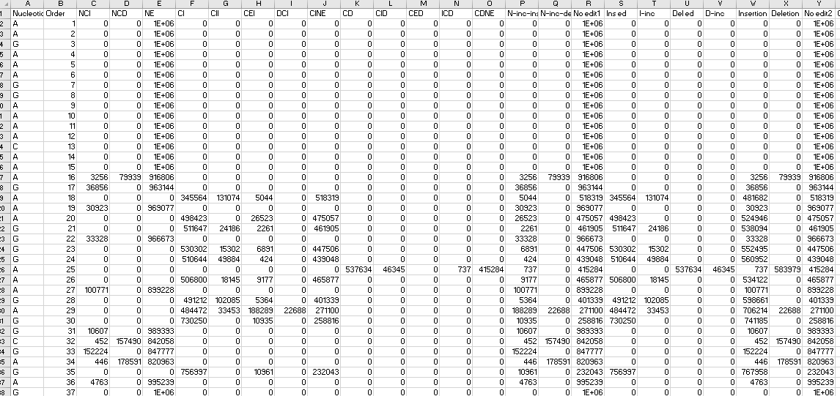
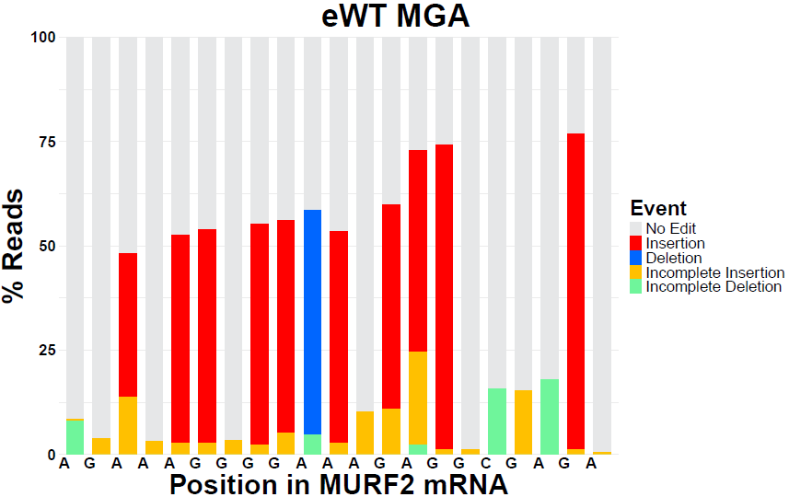
Assigning editing ‘type’ to generate graphs using the categories listed
Insertion = Fully edited insertion
Incomplete insertion = Any insertion that does not match F.E.
Deletion = Fully edited deletion
Incomplete deletion = Any deletion that does not match F.E.
No Edit = No editing observed
MURF2 KREPA6 eWT data
Current version of the ‘bar-graph-data’ output from PARERS and an example graph with the current categories. Red boxes outline the information used to make the indicated bars on the chart. This spreadsheet contains other categorizations of the data to allow for flexibility in the categories included in the output graph.

Slide 27
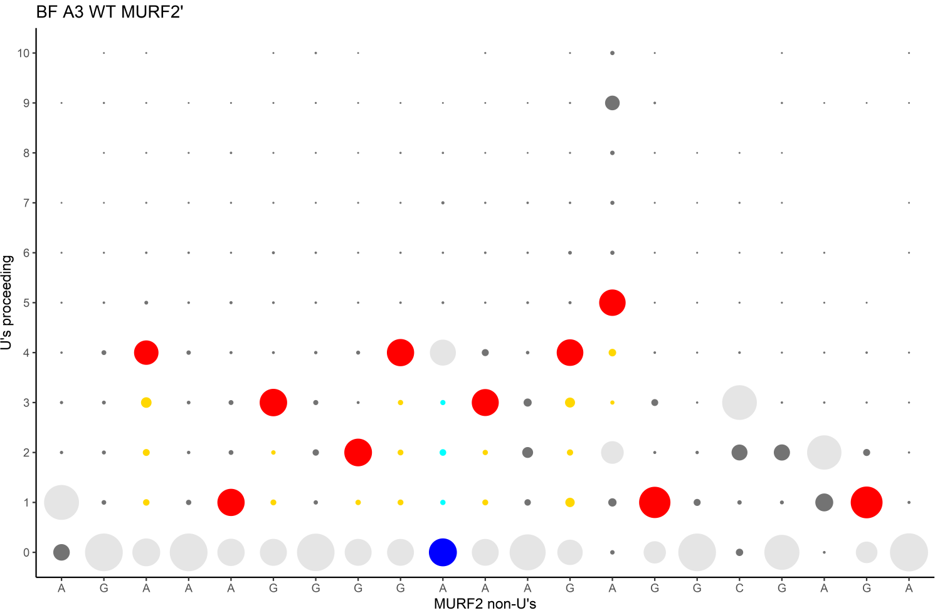
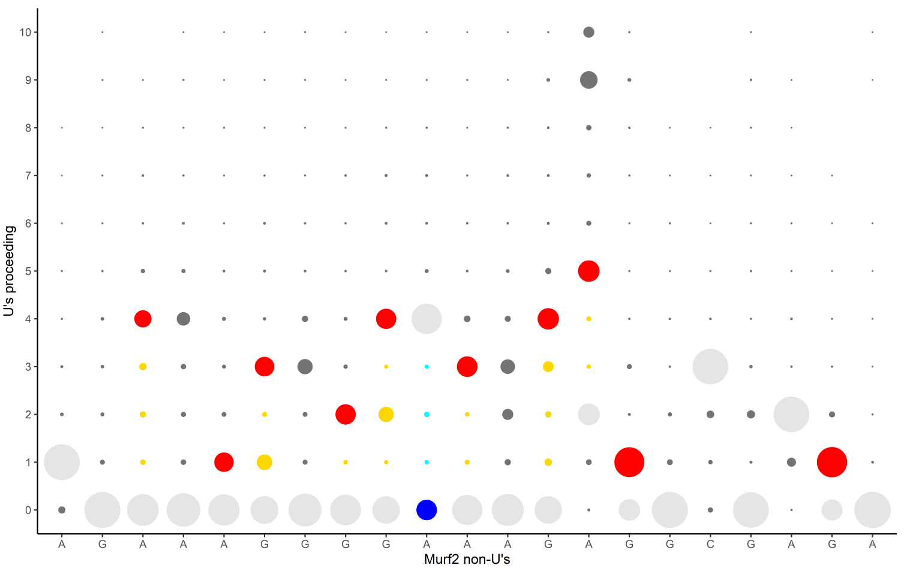
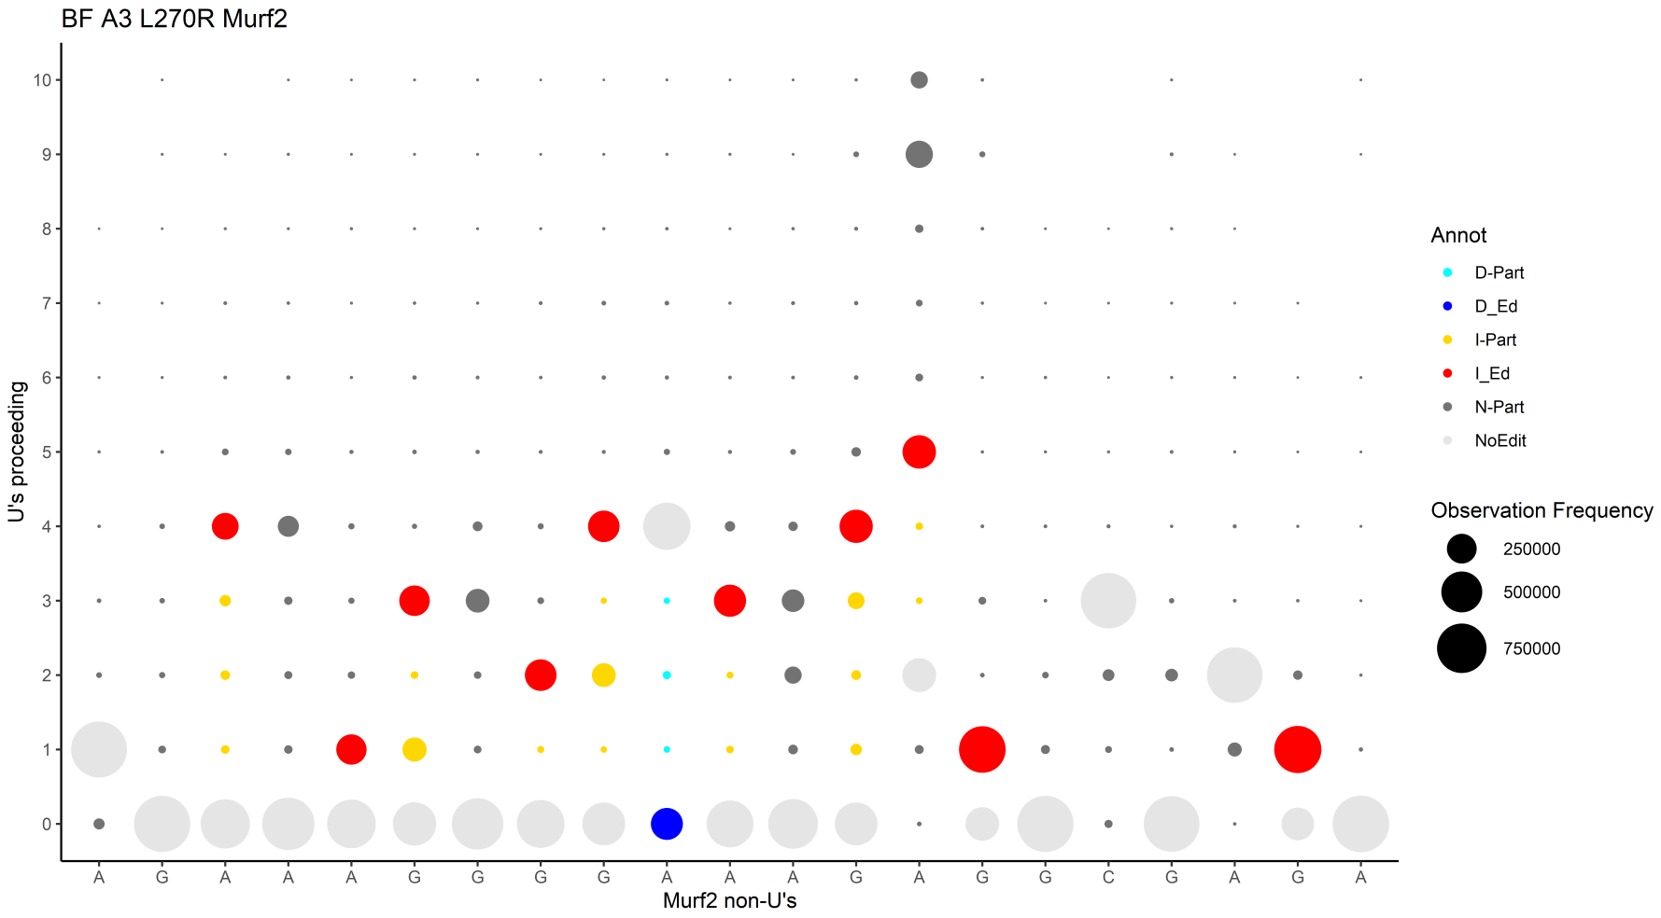
Deep Seq analysis: MURF2 bubble plots & bar charts
WT MURF2
L270R MURF2
10
10
9
9
8
8
7
7
6
6
5
5
# of U
# of U
4
4
3
3
2
2
1
1
0
0
RPMR
Non-U position in MURF2
Non-U position in MURF2
Notes:
This is a slide showing a previous version of our data presentation. I included it because it shows how the bar graphs and bubble plots relate to one another.

